Slide 1
SX28AC Architecture
Notes:
27

Slide 2
SX28 Series
Performance
  Up to 75MIPs performance at 75MHz
  Single cycle (except BRANCH)
  Flash/EEPROM
Deterministic 3 Clock Cycles Internal Interrupt Response & 5 Clock Cycles External Interrupt Response
  Facilitates real time applications
  Allows implementation of hardware functions in software
  Improves performance of end application due to linear response
“Tool on a chip”
  Supports in-System debug and programming
18/28-pin PDIP, 18/28-pin SO and 20/28-pin SSOP packages

Slide 3
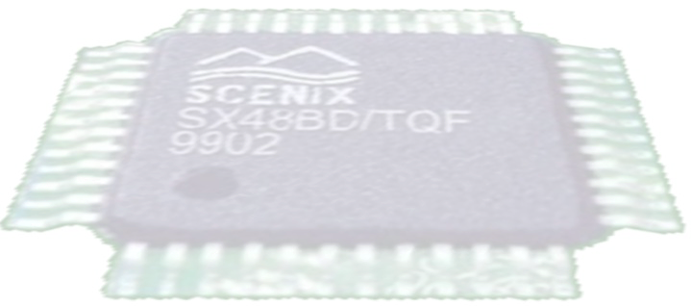
The SX18/20/28 IC Map
Port B
MIWU/IRQ
RTCC
Port A
Comparator
Port C
4
Stage
Pipeline
136
Bytes Ram
CPU
Registers
POR
BOR
2K
Words EEPROM
OSC
ALU
ISD
ISP

Slide 4
SX28 Series Main Features
2K x 12 flash/EEPROM (10,000 cycles)
136 bytes of SRAM
Single-cycle instruction execution
Deterministic three-cycle interrupt response
Runs efficient Virtual PeripheralTM
Hardware interrupts
Programmable read/write protection
In-system programmability
In-system debug capability

Slide 5
On-Chip H/W Peripherals
Power-on Reset
Brown-out Reset
Analog Comparator
8 Interrupt/Multi-Input Wakeup Pins
Watchdog Timer (with dedicated RC oscillator)
8-bit Timer (RTCC) with 8-bit prescaler
I/O are high current sink/source with user configurable weak-pullup, Schmitt-trigger, and TTL/CMOS levels

Slide 6
Instruction Set

Slide 7
Instruction Set Highlights
All single-word (12-bit) for compact code efficiency
All instructions are single-cycle except
  Jump type instructions and failed test instructions which are two-cycles
Program Counter memory-mapped as a register file allows W to be used as offset register
Eight-level, 11-bit Push/Pop hardware stack for subroutine linkage
True bit manipulation
43 Instructions providing Logical, Arithmetic and Shift, Bitwise, Data Movement, Program Control, and System Control Operations
Program Indirect Addressing capability to provide fast and efficient table lookup, fast checksum and CRC calculations during run-time reduce software overhead
Notes:
Instruction Set
Standard
49 instructions in Basic Family
58 instructions in Feature Family
77% single byte/single cycle

Slide 8
SX Hardware Peripherals

Slide 9
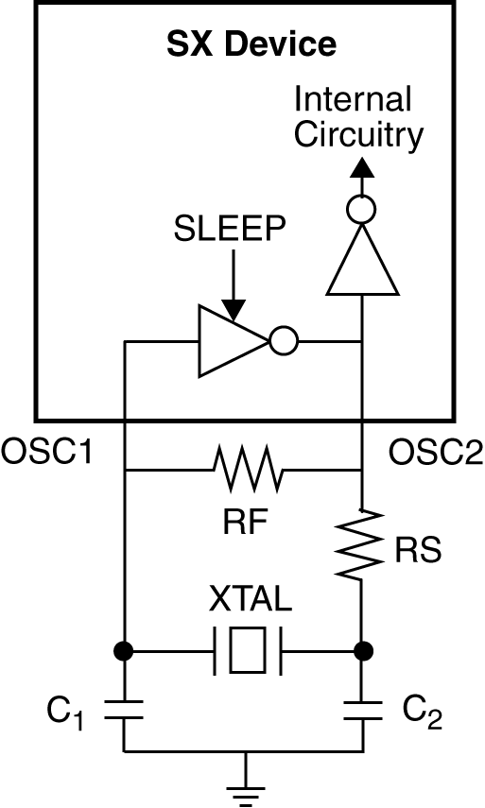
SX Oscillator Options
SX can be driven by the following clock circuit options:
  External RC oscillator
  Crystal/Ceramic resonator
  Crystal oscillator
Internal RC clock can be selected to run at 4 MHz, 1 MHz, 128KHz or 32 kHz
Notes:
55

Slide 10
SX On-Chip Timers
RTCC: 8-bit real-time timer or counter
  incremented on RTCC pin transitions or each instruction cycle
  selected by RTS bit in OPTION register
  rising or falling edge select through RTE bit in OPTION register
WDT
  Provides escape route from infinite loops and other abnormal software condition
  WDT oscillator has a nominal operating frequency of 14 KHz
  It can be enabled or disabled by the WDTE bit in FUSE word
PRESCALAR
  Can be assigned to either RTCC or WDT
  If assigned to WDT, divide down ratio for RTCC is 1:1
  Prescalar divide ratio is set by PS0-PS2 bits in OPTION register
Notes:
56

Slide 11
H/W Interrupt Support
The SX can handle interrupts generated from either internal or external sources:
  Internal sources are:
    RTCC
  External sources are:
    Multi-Input Wake-Up (MIWU) on Port B
All interrupts are treated globally
  This means interrupts are serviced on a first come, first served, basis
  The SX’s ability to handle interrupts is disabled until the current interrupt is finished
  If another external interrupt occurs while SX is executing one interrupt, the bit at WKPND_B register gets set. SX will jump to the ISR after finishing the present ISR.
Notes:
60

Slide 12
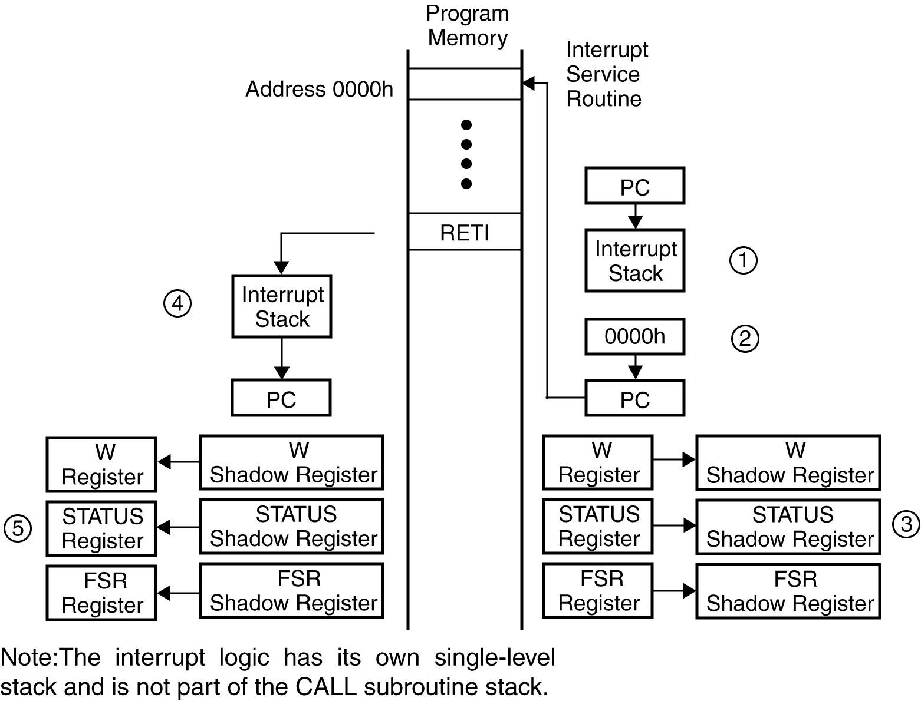
Sequence of Interrupt Handling
Upon acknowledging an interrupt, the PC is pushed onto the stack, and the FSR, STATUS and W registers are saved

Slide 13
Power Down Mode
All activities stopped except
  Watchdog Timer if enabled
Enter Power Down mode
  Execution of SLEEP Instruction
Exit SLEEP mode
  External RESET
  Multi-Input Wakeup (MIWU)
  Watchdog Reset
Notes:
The WATCHDOG logic on the COP888CF is disabled during the HALT mode. However, the clock monitor circuitry if enabled remains active and will cause the WATCHDOG output pin (WDOUT) to go low. If the HALT mode is used and the user does not want to activate the WDOUT pin, the Clock Monitor should be disabled after the device comes out of reset (resetting the Clock Monitor control bit with the first write to the WDSVR register_{CC}) may be decreased to V_{r} (V_{r} = 2.0V) without altering the state of the machine.
Since a crystal or ceramic resonator may be selected as the oscillator, the Wakeup signal is not allowed to start the chip running immediately since crystal oscillators and ceramic resonators have a delayed start up time to reach full amplitude and frequency stability. The IDLE timer is used to generate a fixed delay to ensure that the oscillator has indeed stabilized before allowing instruction execution. In this case, upon detecting a valid Wakeup signal, only the oscillator circuitry is enabled. The IDLE timer is loaded with a value of 256 and is clocked with the tC instruction cycle clock. The tC clock is derived by dividing the oscillatore CKI inverter on the chip ensures that the IDLE timer is cocked only when the oscillator has a sufficiently large amplitude to meet the Schmitt trigger specificationsom the IDLE timer enables the clock signals to be routed to the rest of the chip.
If an RC clock option is being used, the fixed delay is introduced optionally. A control bit, CLKDLY, mapped as configuration bit G7, controls whether the delay is to be introduced or not. The delay is included if CLKDLY is set, and excluded if CLKDLY is reset. The CLKDLY bit is cleared on reset.
The COP888CF has two mask options associated with the HALT mode. The first mask option enables the HALT mode feature, while the second mask option disables the HALT mode. With the HALT mode enable mask option, the COP888CF will enter and exit the HALT mode as described above. With the HALT disable mask option, the COP888CF cannot be placed in the HALT mode (writing a “1” to the HALT flag will have no effect).
The WATCHDOG detector circuit is inhibited during the HALT mode. However, the clock monitor circuit if enabled remains active during HALT mode in order to ensure a clock monitor error if the COP888CF inadvertently enters the HALT mode as a result of a runaway program or power glitch.
NOTE: It is necessary to program two NOP instructions following both the set HALT mode and set IDLE mode instructions. These NOP instructions are necessary to allow clock resynchronization following the HALT or IDLE modes.

Slide 14
Multi Input Wake-Up (MIWU)
MIWU allows the SX to be awakened from Sleep mode by an externally generated event
  When the SX is in Sleep mode, a state transition on one of the Port B pins will wake-up the device
  MIWU characteristics (rising/falling edge detect, enabled/disabled) are controlled through the Port B control registers:
  Each pin in port B can be individually assigned, and the default values on power-up/reset are for MIWU to be disabled
Notes:
62

Slide 15
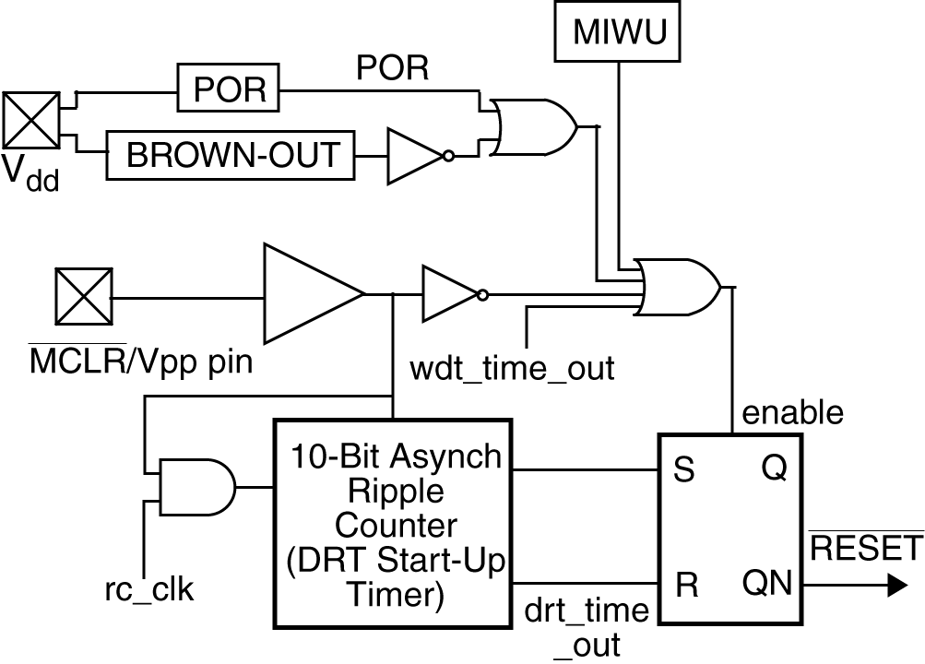
Brown Out and POR
Reset circuit used to generate resets during power up and brown out
Brown-out circuit can be enabled or disabled at programming
Selectable Brown out level (4.2V, 2.6V or 2.2V)
On reset, Delay Reset Timer (DRT) begins counting once MCLR_ goes high timeout period is typically 72 ms

Slide 16
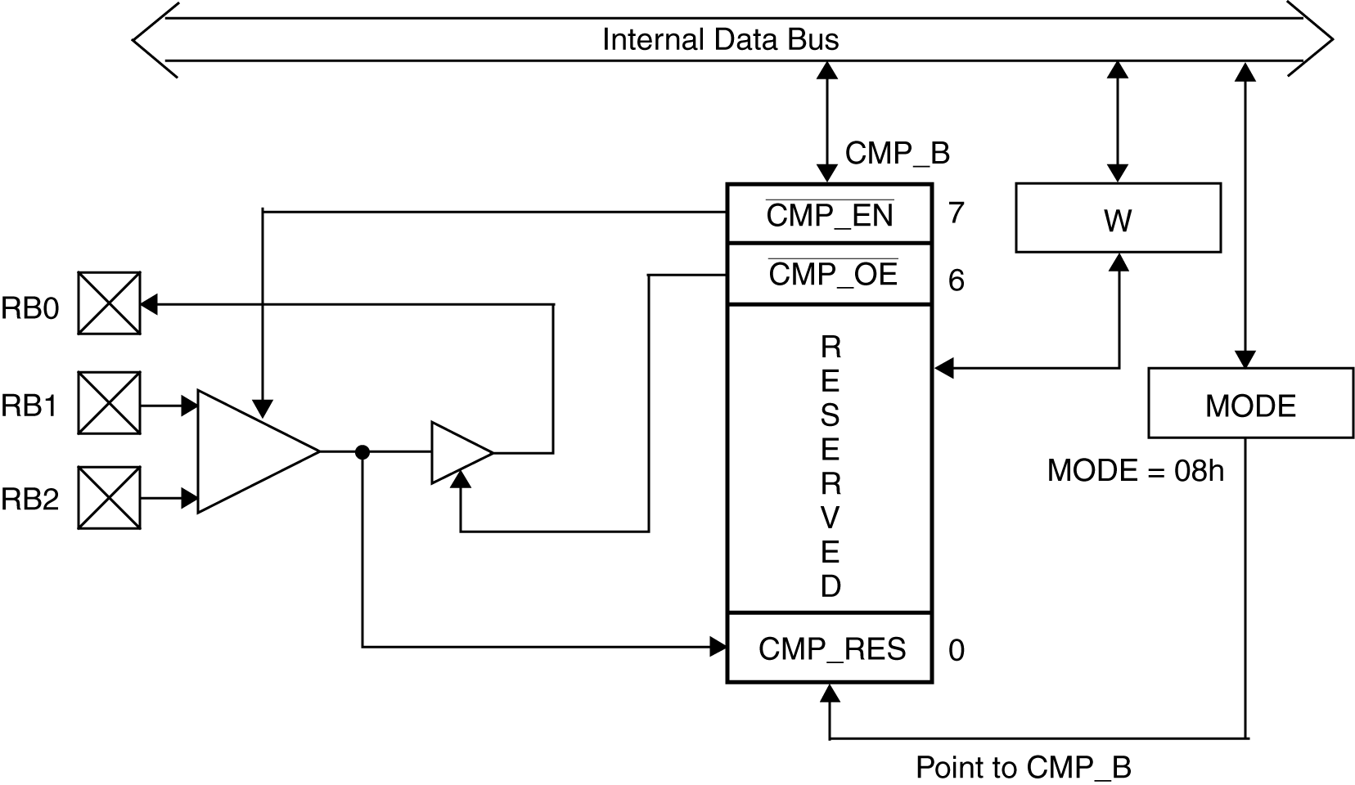
Differential Comparator
All bits are active low
The CMP_RES output in this register can be used in place of using up the RB0 port pin, saving one I/O pin
It is not disabled in Sleep Mode unless done explicitly using cmpen bit

Slide 17
SX52BD Architecture
Notes:
27

Slide 18
SX52 Series Differentiation
All features of SX28 Series, with the addition of:
Up to 100 MIPS Performance at 100 MHz
4096x12 EE/Flash Program Memory (10,000 cycles)
262x8 SRAM
16 or 20 additional I/O – 36/40 total
Two additional Multi-Function 16-bit Timers with 8-bit prescalers and interrupt capability
Improved performance Analog Comparator
MODE register shadow on interrupt
Clock buffer can be disabled to save power
Clock can be enabled during Sleep Mode
Selectable timeout period to Wake-up from SLEEP
52-pin PQFP and 48-pin TQFP packages

Slide 19
The SX52 IC Map
Port B
MIWU/IRQ
16-bit Timer
Port C
Port D
RTCC
Port A
Comparator
16-bit Timer
Port E
4
Stage
Pipeline
262
Bytes Ram
CPU
Registers
POR
BOR
4K
Words EEPROM
OSC
ALU
ISD
ISP

Slide 20
Powerful 16-bit Timers
Each timer contains a 16-bit counter and two Compare/Capture registers and an 8-bit prescaler
Timer Operating Modes
  PWM Mode
  Software Timer Mode
  External Event mode
  Capture/Compare Mode
Possible Applications:
  Fast and efficient PWM generation
  Motor Control: Smooth waveforms allow an optimization of power elements and input filters, low system cost, better reliability
  Display intensity control
  Sound generation
  Inputs for data acquisition and sine wave generators
  Precise input waveform measurement

Slide 21
Timer Applications
Possible Applications:
  Fast and efficient PWM generation
  Motor Control: Smooth waveforms allow an optimization of power elements and input filters, low system cost, better reliability
  Display intensity control
  Sound generation
  Inputs for data acquisition and sine wave generators
  Precise input waveform measurement
  Simultaneous PWM generation while measuring the input waveform
  Motor speed regulation
  Bus speed measurement
  PWM generation while clocking the timer from an external source
  PLL function

Slide 22
Scenix Virtual PeripheralTM Concept

Slide 23
Virtual PeripheralTM Concept
A ‘Virtual Peripheral’ can be defined as software that provides functions implemented on other as on-chip hardware blocks, or as additional hardware components.
Some common examples include:
  UART
  PWM
  Timers
  ADC
  DAC
  Modem
  DTMF I/O
  I²C Interface
  SPI/mWire
  And many, many more...

Slide 24
Virtual PeripheralTM Concept Cont’d
An application can be broken up into 3 distinct areas of code:
  Resource Allocation
    global registers for semaphores - flags, reference passing
    interface registers for each module
  Interrupt Service Routine (ISR)
    where the Virtual PeripheralTM real time tasks reside
  Subroutines
    any supporting or non-real time functions for the Virtual PeripheralTM

Slide 25
Virtual PeripheralTM Integration
Virtual PeripheralTM modules can be combined into one piece of software to be programmed into the SX.
The designer can choose the combination of Virtual PeripheralTM modules, within the following limits:
  RAM, ROM resources usage
  I/O usage
  MIPS required
Scenix literature publishes all of these specs with the release of each Virtual PeripheralTM

Slide 26
Integration Cont’d
Application
Software
The following example shows an
application which requires a
UART, 16-bit Timer and DTMF:
All registers are allocated in RAM
The ISR portions of each Virtual PeripheralTM are combined into one consecutively executed piece of code.
Any subroutines which are required are then added to the code.
RAM Allocation
Timer registers
DTMF registers
UART registers
Interrupt Service Routine
Timer
DTMF
UART
Main
Initialization
Main code logic
DTMF subroutines
UART subroutines

Slide 27
Integration Cont’d
Some Virtual PeripheralTM modules have very specific timing considerations, i.e.
  UART, for baud rate generation
  DTMF, for target frequency references
To ensure proper timing, the RTCC value used will need to be calculated.
  A formula is provided with each module which has specific timing needs to aid in choosing an RTCC value, or to adjust timing constants to a given RTCC.
When multiple modules are being used, each with different RTCC values, some modification may be required:
  A ‘common denominator’ may be found across all the modules
  Timing constants can be adjusted to a given RTCC.

Slide 28
Sources and Types of Virtual PeripheralTM
Telephony
DTMF Detection
DTMF Generation
FSK Detection
FSK Generation
Caller ID
Ring Detect
Call Progress Detect
Call Progress Generation
FSK 202 R2R
DTMF Generation R2R
Pulse Dial Receive
Pulse Dial Generation
Interface
I2C Master
I2C Slave
I2C Multi-Master
SPI/uWire Master Interface
SPI/uWire Slave Interface
2400-230.4K UART
Eight UART (19.2 Baud)
Scenix.com
Free Ware
@
www
Display
4-Bit LCD Interface
8-Bit LCD Interface
Driving 7 Segment LED
PWM Bar Graph
LCD Driver
Virtual Peripherals
Library
Signal
Dual 8-Bit PWM's
Eight 8-Bit PWM's
Sigma Delta ADC
Artificial Sine Wave
Generator
General
16-Bit Timer
4x4 Keyboard Scan
Real-Time Clock
Push Button Debounce
Your IP

Slide 29
SX Function Specific Solution:
Bell 202s Modem
Analog line
Analog line
PWM
PWM
DTMF
Detection
A/D
Converter
FSK
Detection
Ring
Detect
DTMF
Generation
FSK
Generation
Oscillator
SX28AC
8-bit uC Core
Caller
ID
Osc.1
Osc.2
In-system
programming
Brown-out
Detection
16-bit
Timer 1
UART
SPI
Interface
2K*12
FLASH
136 B
SRAM
Vcc
To RS232
SPI bus
Hardware Blocks
Virtual PeripheralTM

